Slide 1

Welcome!
2026 Township Annual Meeting

Slide 2
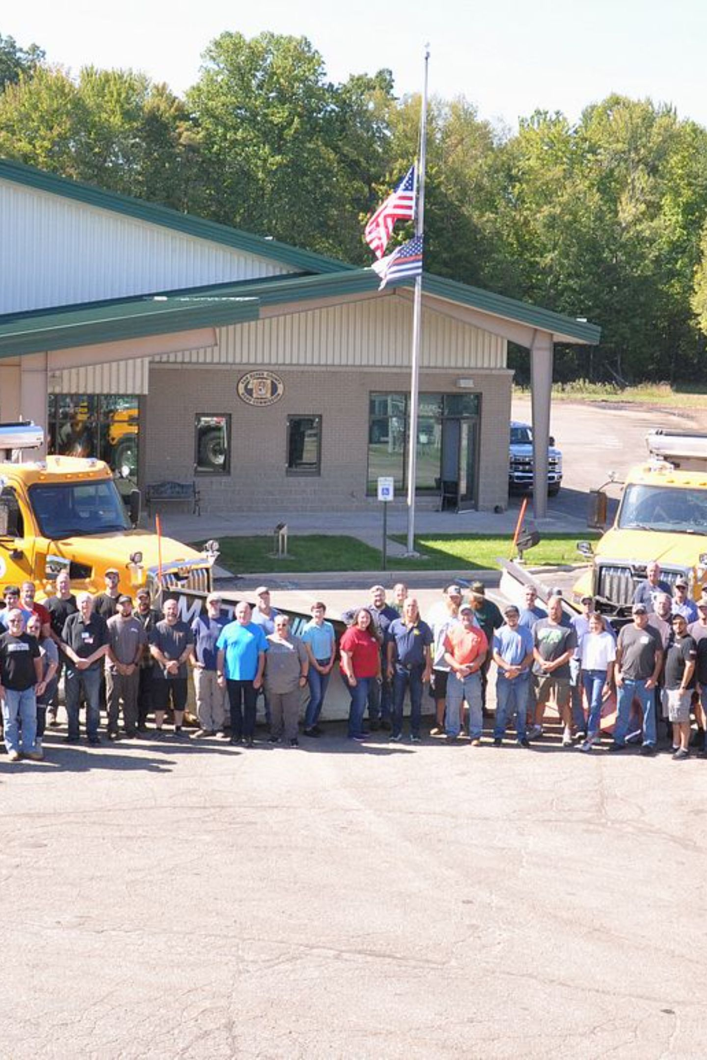
2026 Township Annual Meeting
Road Planning, Maintenance & Long-Term Investment
A practical guide for township officials and board members on road tours, planning deadlines, long-term strategies, and maintenance options — in partnership with the Van Buren County Road Commission (VBCRC).

Slide 3
AGENDA
What We'll Cover Today
01
02
Road Tour Program
Planning Deadlines
Purpose, scheduling, and who should attend
Key dates and why they matter
03
04
Building a Long-Term Plan
Maintenance & Improvement Options
Data tools, resources, and smart strategies
Matching the right fix to the right condition

Slide 4
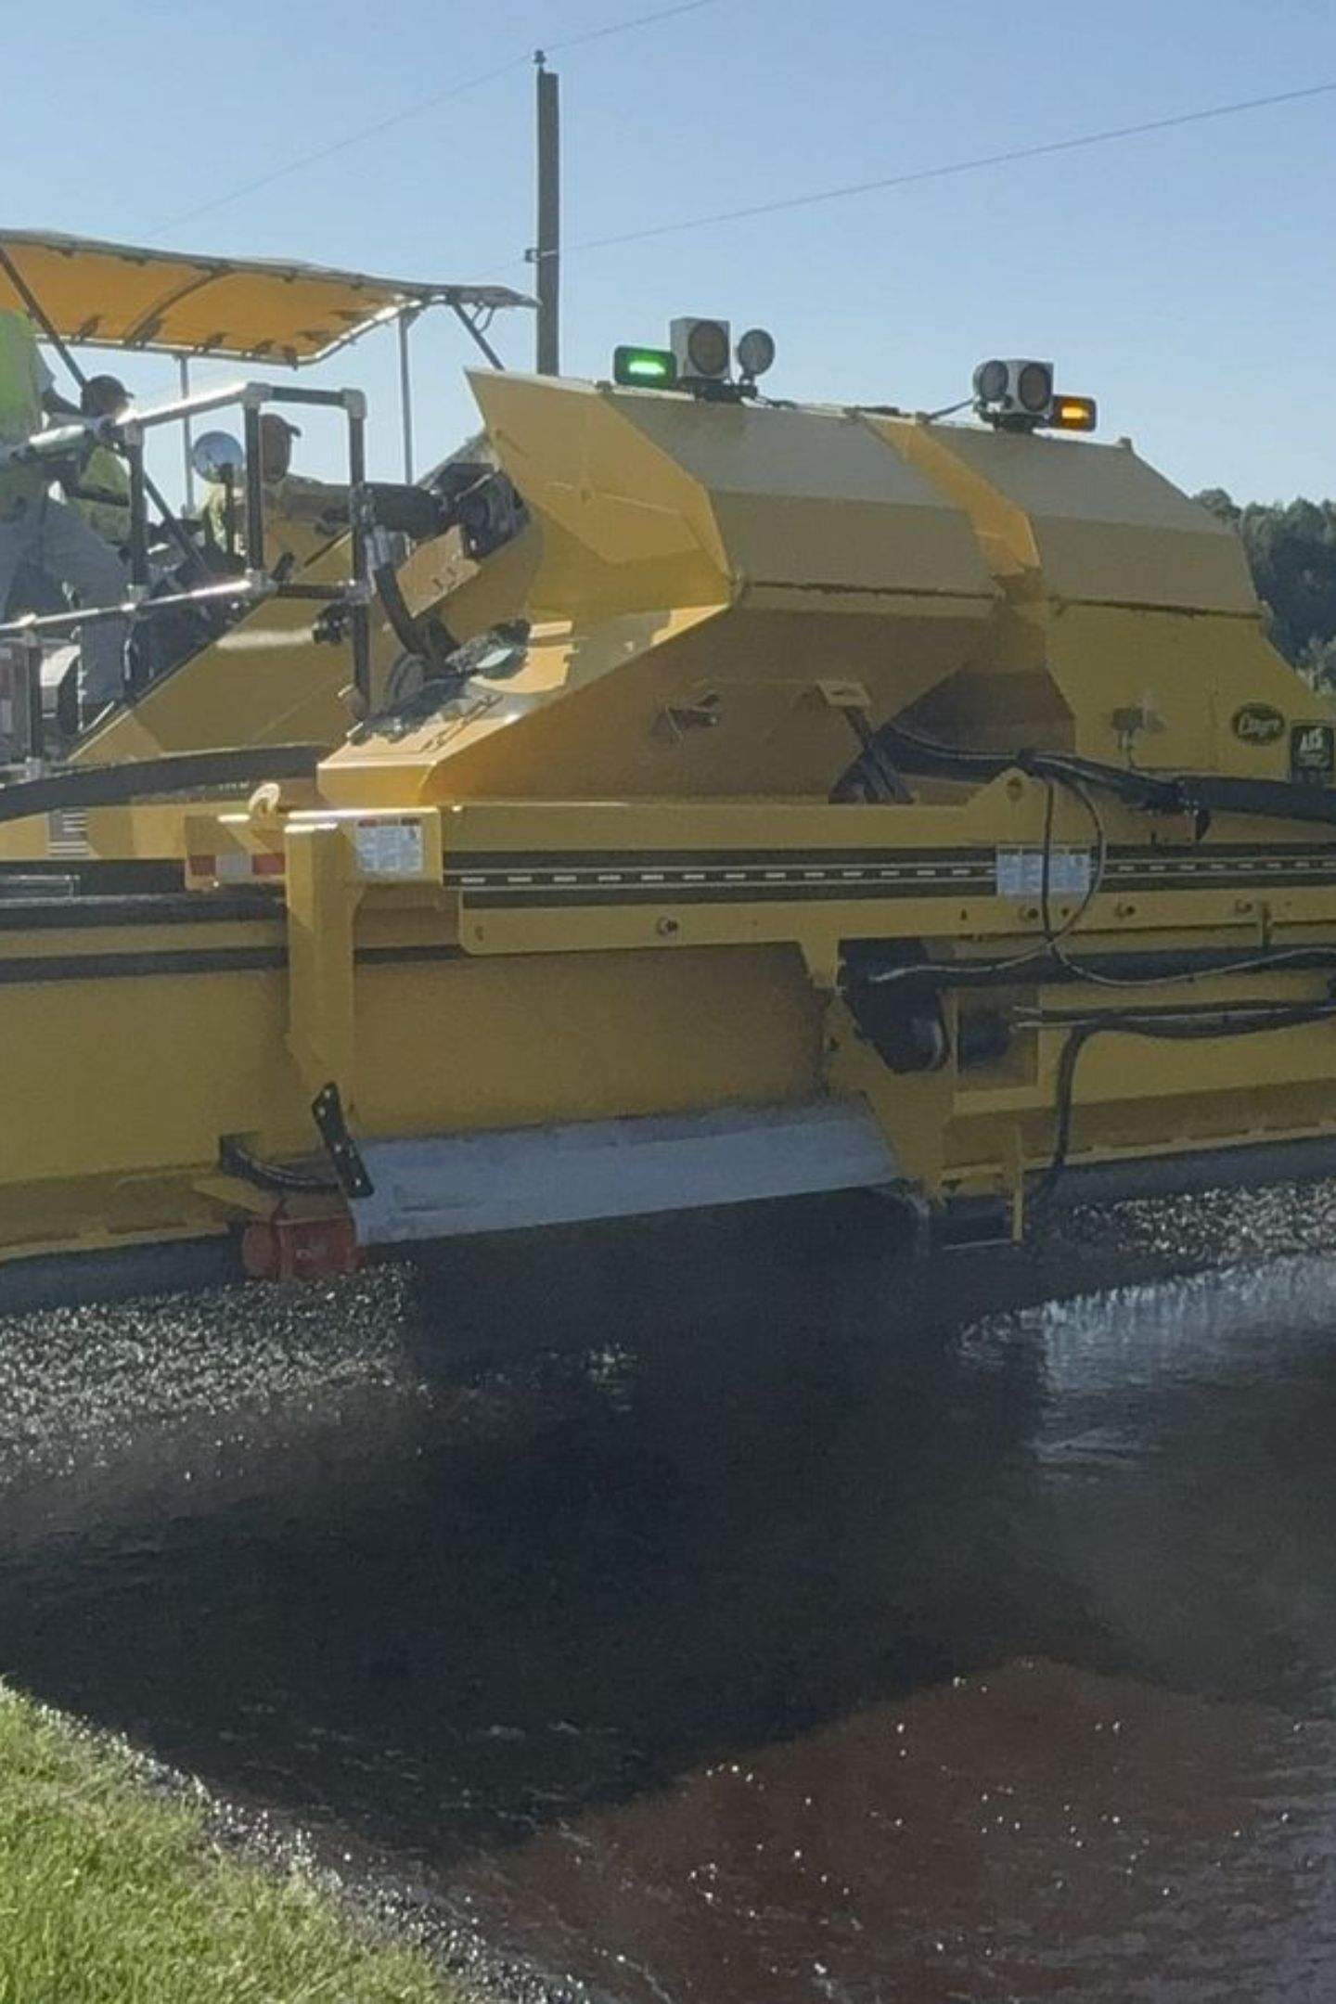
CHAPTER 1
Road Tours: Purpose & Value
Road tours with VBCRC staff are one of the most valuable tools available to township officials. Whether you're new to your role or a seasoned board member, walking or driving the roads alongside our staff provides firsthand insight that no map or spreadsheet can fully replace.

Slide 5

ROAD TOURS
When Can Road Tours Happen?
Any Time of Year
Spring Tours
Fall Tours (Encouraged)
Road tours with VBCRC staff can be scheduled at any time — there is no wrong season to walk your roads with us.
The most common tour season. Spring conditions reveal winter damage, drainage issues, and surfaces in need of early attention.
Now actively encouraged to help townships complete their Road Planning Form before the end-of-year deadlines.
Fall tours are a newer best practice — they give you a head start on planning before the December 31st submission deadline.

Slide 6
ROAD TOURS
Who Can Attend & What Gets Covered
Open to All Township Officials
Topics Covered on Tour
Road tours are not limited to a single representative. Board members, supervisors, trustees, and clerks are all welcome — the more stakeholders involved, the better the planning outcomes.
General road maintenance education — learn how road deterioration works and what treatments apply
Project-specific guidance — get expert eyes on roads you're actively planning for
Resident request reviews — evaluate common complaints and concerns in context

Slide 7
CHAPTER 2
Important Planning Deadlines
Meeting planning deadlines is essential to keeping your township's road projects on track. Delays in any step — from submitting your plan request to approving final locations — can push your entire project to the following year. Here's what you need to know.
October 31st
March 31st
Submit request for a VBCRC-assisted township road plan
Program Sheets with Actual Locations must be signed
1
2
3
4
December 31st
As soon as possible
Township Plans are due to VBCRC
Sealcoat prep and maintenance work begins in the field

Slide 8
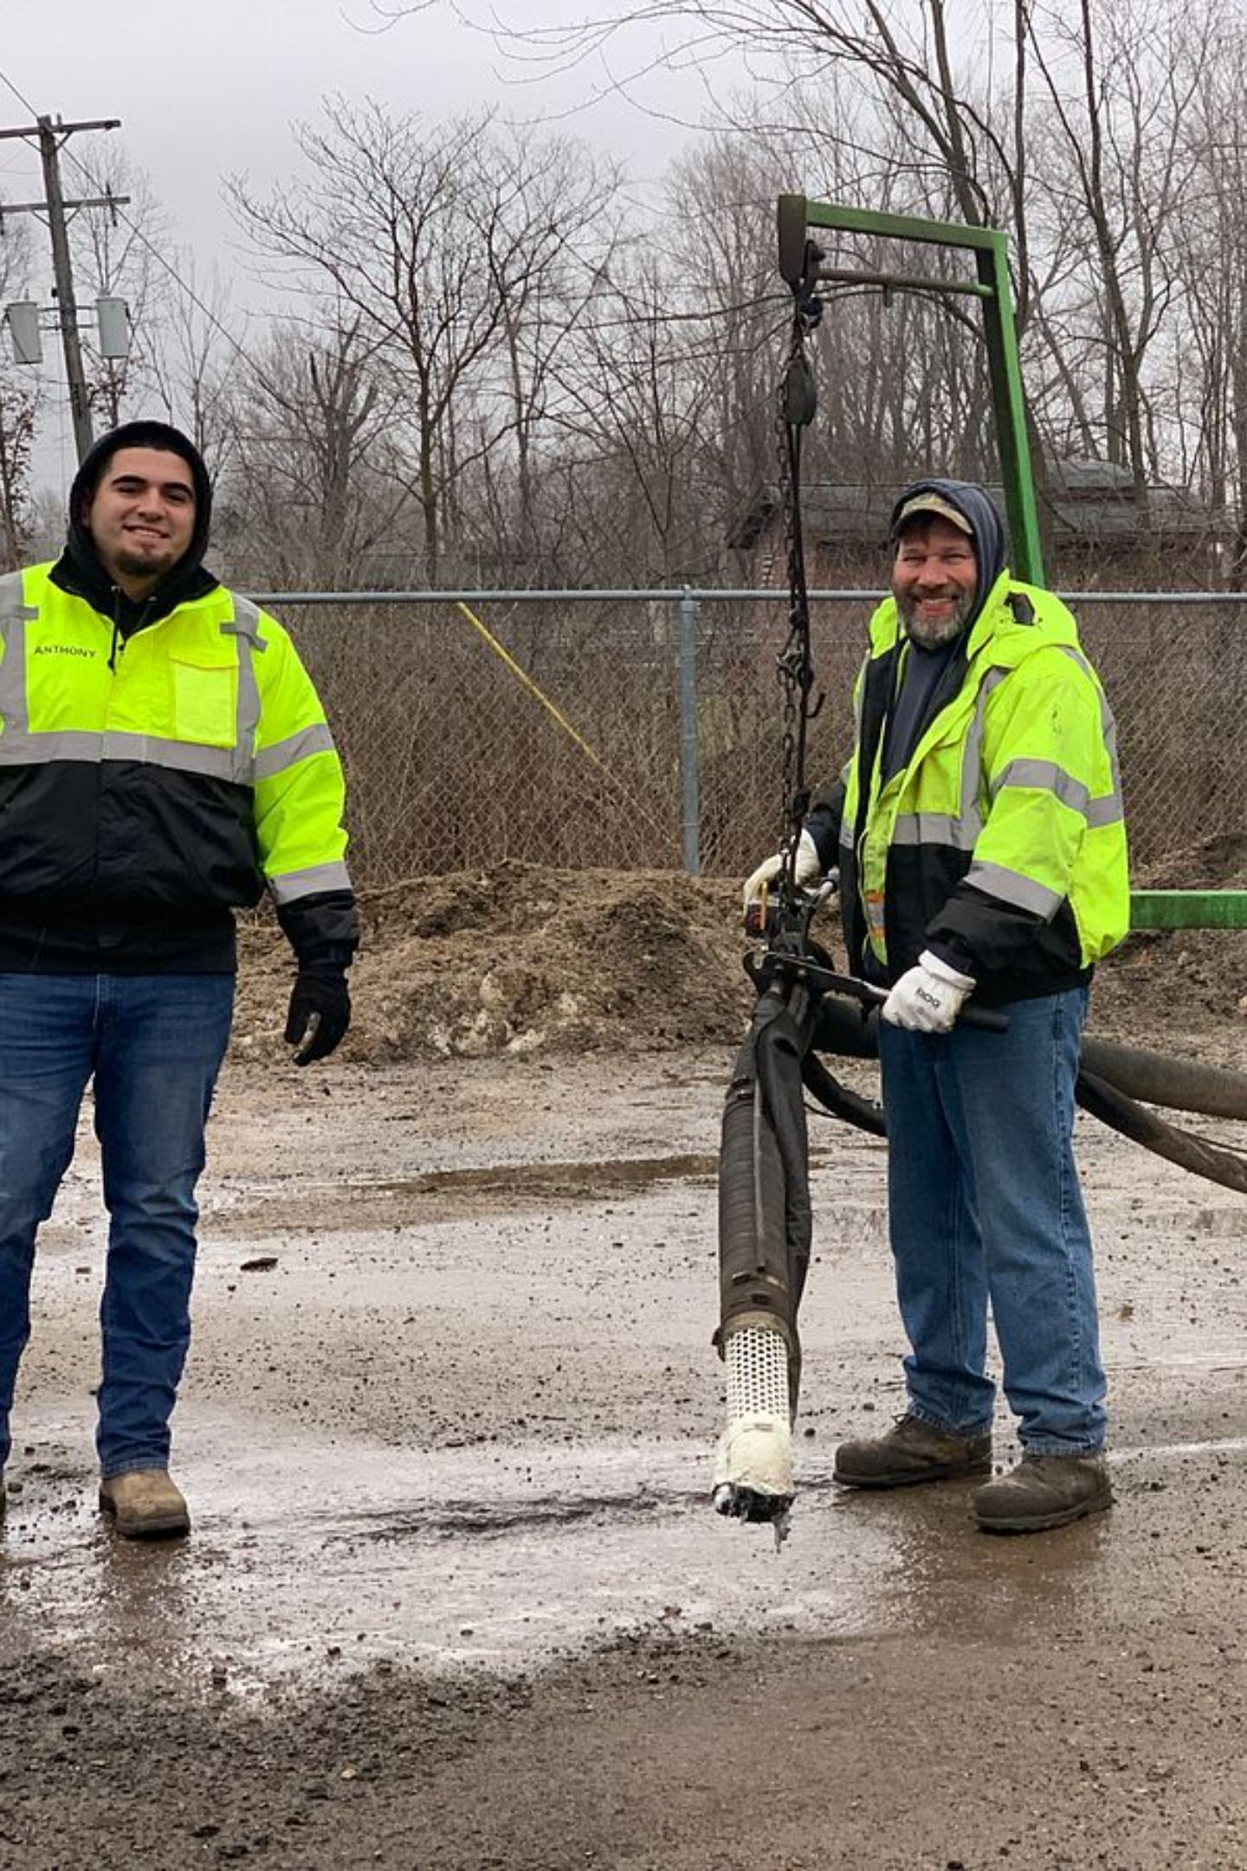
DEADLINES
Why These Deadlines Matter
The March 31st Program Sheet deadline exists for critical operational reasons. Before sealcoating can begin, roads must be evaluated for culvert replacements, patching needs, and potential de-berming. In many cases, patching cannot be completed until de-berming is finished first — making the sequence of approvals time-sensitive.
Delayed location approvals create a ripple effect that can stall the entire pre-treatment process, pushing your project out of the current year's program entirely.

Slide 9

DEADLINES
What Happens If You Miss a Deadline?
Late Plan Requests
Late Program Sheets
If a township submits its VBCRC plan request after October 31st, the request will be added to the plan for the following year. There is no exception process — the earlier you act, the better positioned your township will be.
Missing the March 31st deadline for Program Sheets with Actual Locations means pre-treatment evaluations cannot begin on schedule. This delays patching, de-berming, and ultimately sealcoat application — compressing or eliminating your project window for that season.
Late requests cannot be accommodated in the current year's program. Plan ahead to protect your township's road investment.

Slide 10
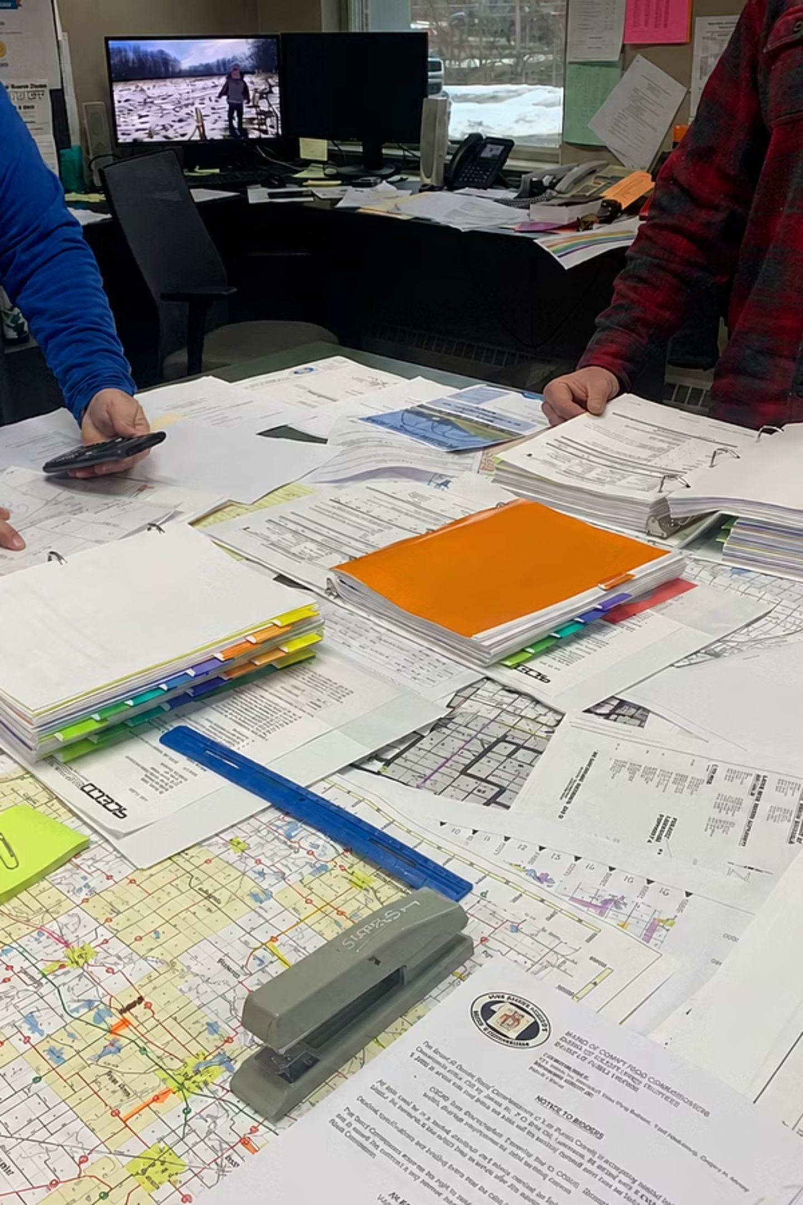
CHAPTER 3
Building a Long-Term Road Plan
A strong long-term road plan protects your current infrastructure investments, stretches limited budgets further, and avoids costly emergency repairs. The best plans combine field observation, data tools, and input from VBCRC staff.

Slide 11
LONG-TERM PLANNING
Protect What You've Already Built
Sealcoat Extends Road Life
Sun & Drainage = Longevity
Applying sealcoat to recently paved roads is one of the highest-return investments a township can make. Sealcoat can extend the life of a road by up to 40% by protecting the surface from oxidation, water infiltration, and UV damage.
Think of it like painting a deck — done at the right time, it dramatically delays the need for costly reconstruction.
Roads with good sun exposure and proper drainage outlast shaded, poorly drained roads significantly. Factor environmental conditions into your project prioritization and expected road lifespans.

Slide 12
LONG-TERM PLANNING
Use Data to Drive Decisions
PASER Ratings
Traffic Counts
Use standardized Pavement Surface Evaluation and Rating (PASER) scores to objectively assess road conditions across your township and prioritize where limited funds have the greatest impact.
Counts have been completed on all township roads in the last 4 years. Up-to-date counts can be requested at any time. Higher-traffic roads may warrant faster intervention and stronger treatment options.
Historic Project Files
Resident Requests
VBCRC maintains records of past road projects. Reviewing project history helps you understand what treatments have been applied, how roads have performed, and what may be needed next.
Future Road Improvement requests submitted by residents provide qualitative insight into community priorities. Cross-reference these with PASER ratings and traffic data for a complete picture.

Slide 13
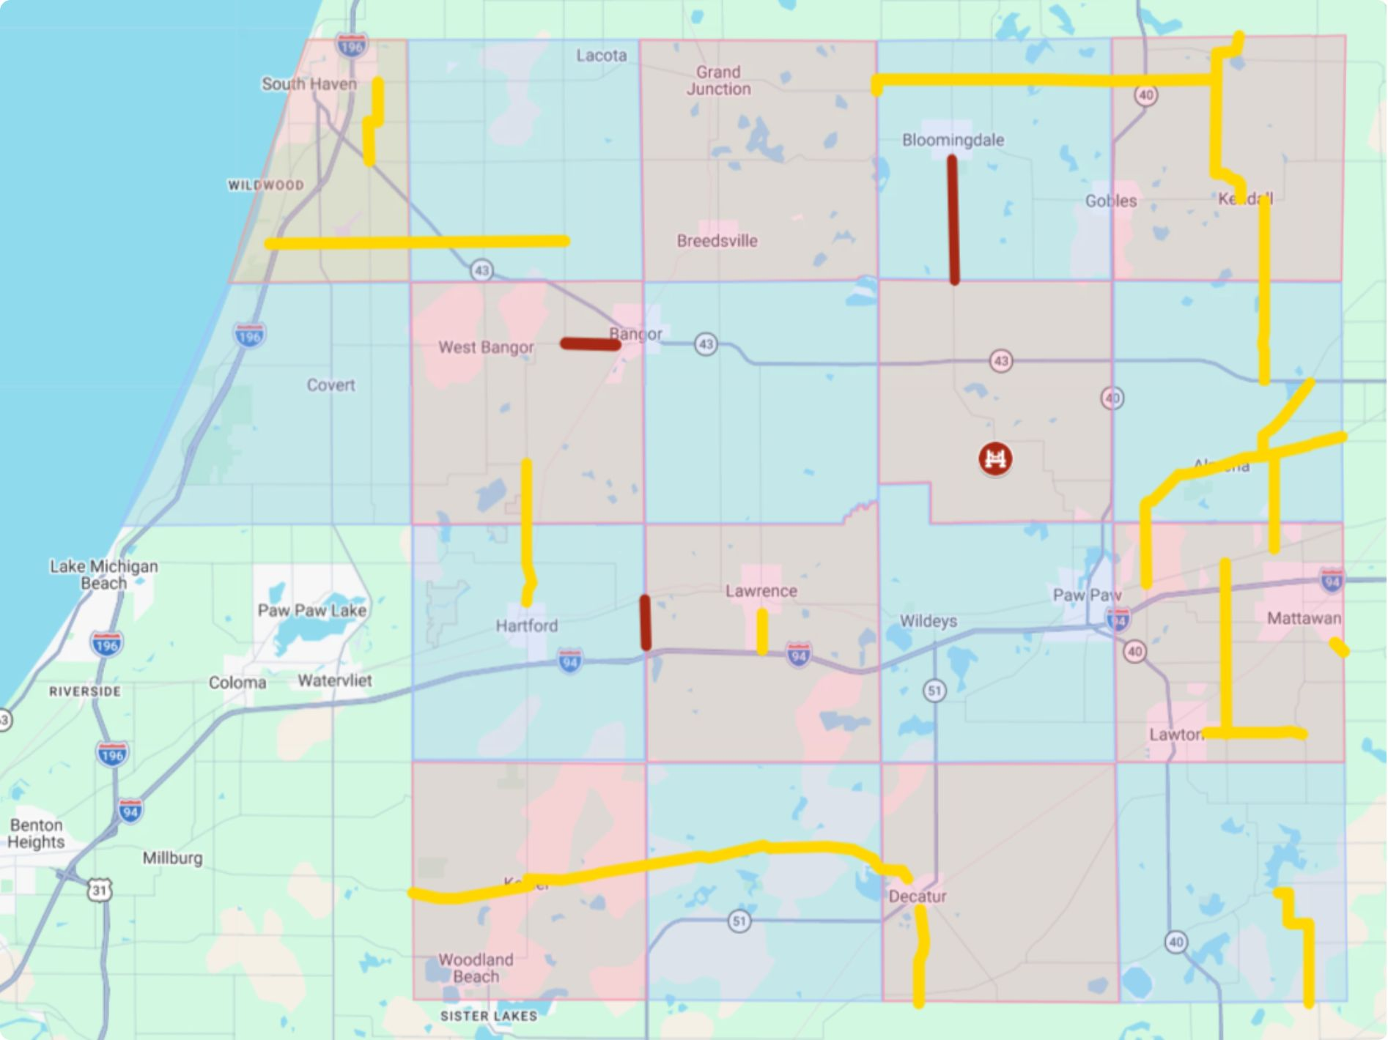
LONG-TERM PLANNING
Our 2027 Road Plan: A Data-Driven Approach
Leveraging comprehensive data from PASER ratings, traffic counts, and historical project files, the VBCRC has finalized the 2027 primary road planning. This map provides a visual overview of prioritized projects and condition assessments, illustrating how data informs our strategic decisions for township road maintenance and improvements.
Yellow on the map represents the planned sealcoat operations and the red indicates the primary road and bridge heavy maintenance projects for 2027.

Slide 14

LONG-TERM PLANNING
A Step-by-Step Planning Approach
Compare Data
Review Records
Narrow Targets
Match Budget
By layering objective data with budget reality, townships can make confident, defensible road investment decisions year after year.

Slide 15
LONG-TERM PLANNING
Plan Large Projects in Stages
Think Multi-Year
Ask VBCRC for Help
Large road reconstruction or improvement projects don't have to happen all at once. Breaking a major corridor into phases allows your township to spread costs across budget years, maintain cash flow, and still make measurable progress.
Early planning also gives VBCRC staff time to assist with engineering assessments, grant eligibility, and scheduling.
When in doubt, reach out. VBCRC staff are a resource — not just a contractor. Whether you need help interpreting PASER data, reviewing a Future Road Improvement request, or understanding your options, staff are available to walk you through it.
Road tours available year-round
Historic project file access on request
Traffic count updates available upon request

Slide 16
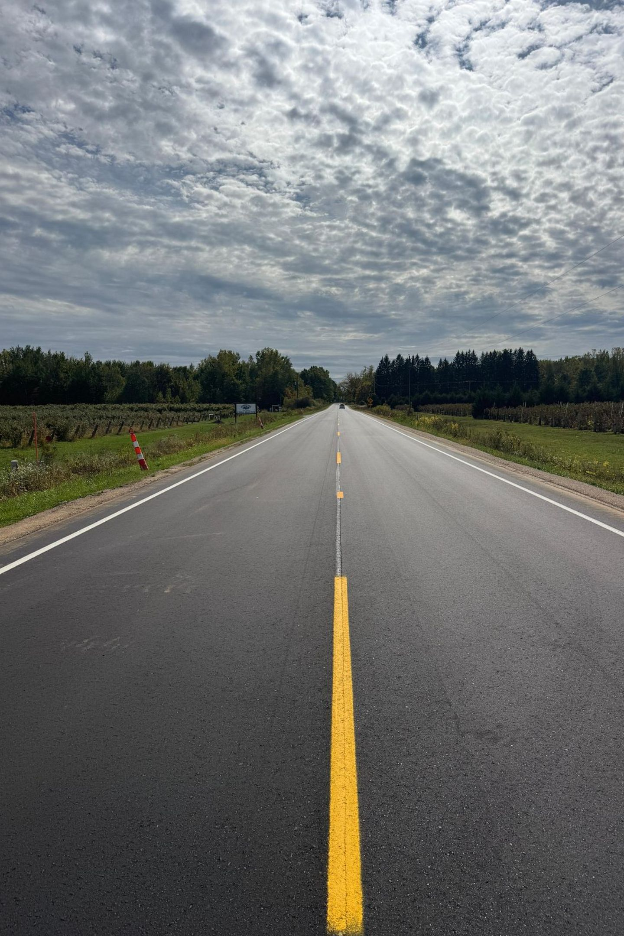
CHAPTER 4
Road Maintenance & Improvement Options
Not every road problem has the same solution — and applying the wrong treatment to the wrong condition wastes money and fails to extend road life. Understanding your options, and their appropriate applications, is the foundation of sound road stewardship.

Slide 17
MAINTENANCE & IMPROVEMENTS
The Right Fix for the Right Condition
Assess Existing Pavement Condition
Consider Drainage & Environment
The condition of the existing roadway is the starting point for every decision. A road in good condition with minor surface cracking needs a very different response than a road with structural base failure. Use PASER ratings and on-the-ground inspection to establish a baseline.
Drainage quality, tree canopy coverage, and sun exposure all affect which treatments will perform well — and for how long. A sealcoat applied to a chronically wet or heavily shaded road may underperform compared to one on a well-drained, sunny corridor.
Set Realistic Expectations
Factor in Available Funding
Every maintenance or improvement option comes with realistic performance expectations. Maintenance treatments are designed to maintain — not restore — road condition. Understanding this distinction helps boards communicate outcomes to residents and plan responsibly for future needs.
The best technical solution must be balanced against available budget. When funding is limited, prioritizing the right roads — using traffic counts, PASER data, and historical project data — ensures the greatest community benefit from every dollar spent.

Slide 18
MAINTENANCE & IMPROVEMENTS
Streamlined Project Bidding
Starting with the 2027 construction season, we're introducing changes to expedite project awards and maintain momentum for road improvements.
Bids Under Engineer's Estimate
Bids Over Engineer's Estimate
Projects with bids that come in under the signed Engineer's estimated cost will be automatically awarded to the lowest bidder. No additional Township approval will be required, saving valuable time.
If a bid comes in higher than the Engineer's estimate, the Township will be presented with an updated program sheet. This allows the board to review and determine whether to proceed with the project or cancel it.
This process minimizes delays for contractors, allowing them to schedule work and secure bonds more efficiently, ensuring projects stay on track.

Slide 19
Key Takeaways & Next Steps
Schedule a Road Tour
Mark Your Deadlines
Contact VBCRC to arrange a spring or fall road tour for your township officials
Oct 31 · Dec 31 · Mar 31 — add these to your board calendar now
Request Your Data
Partner With VBCRC
Ask VBCRC for your current traffic counts and PASER ratings to begin building your long-term plan
Use staff as a resource — from plan development to on-site guidance and historic project review
Questions? Reach out to VBCRC staff at any time. We're here to help your township make the most of every road dollar.

Slide 20
Questions?

